Slide 1
Cemex- East Fort Pierce
1110007
March 27, 20098

Slide 2
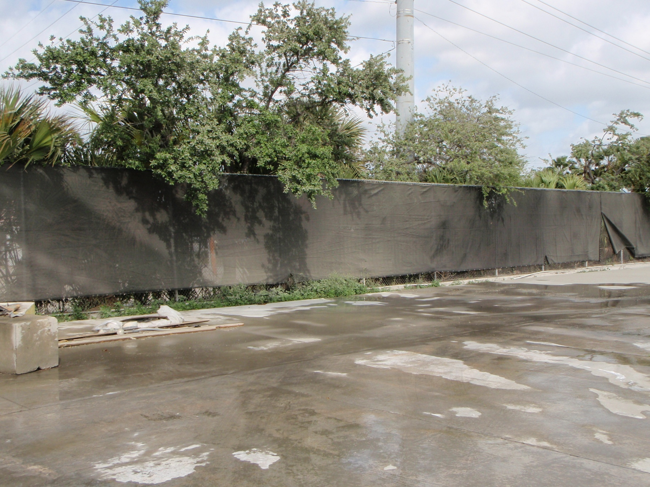
Cement dust on the plants from the initial release. The facility has water the ground to reduce the dust.

Slide 3
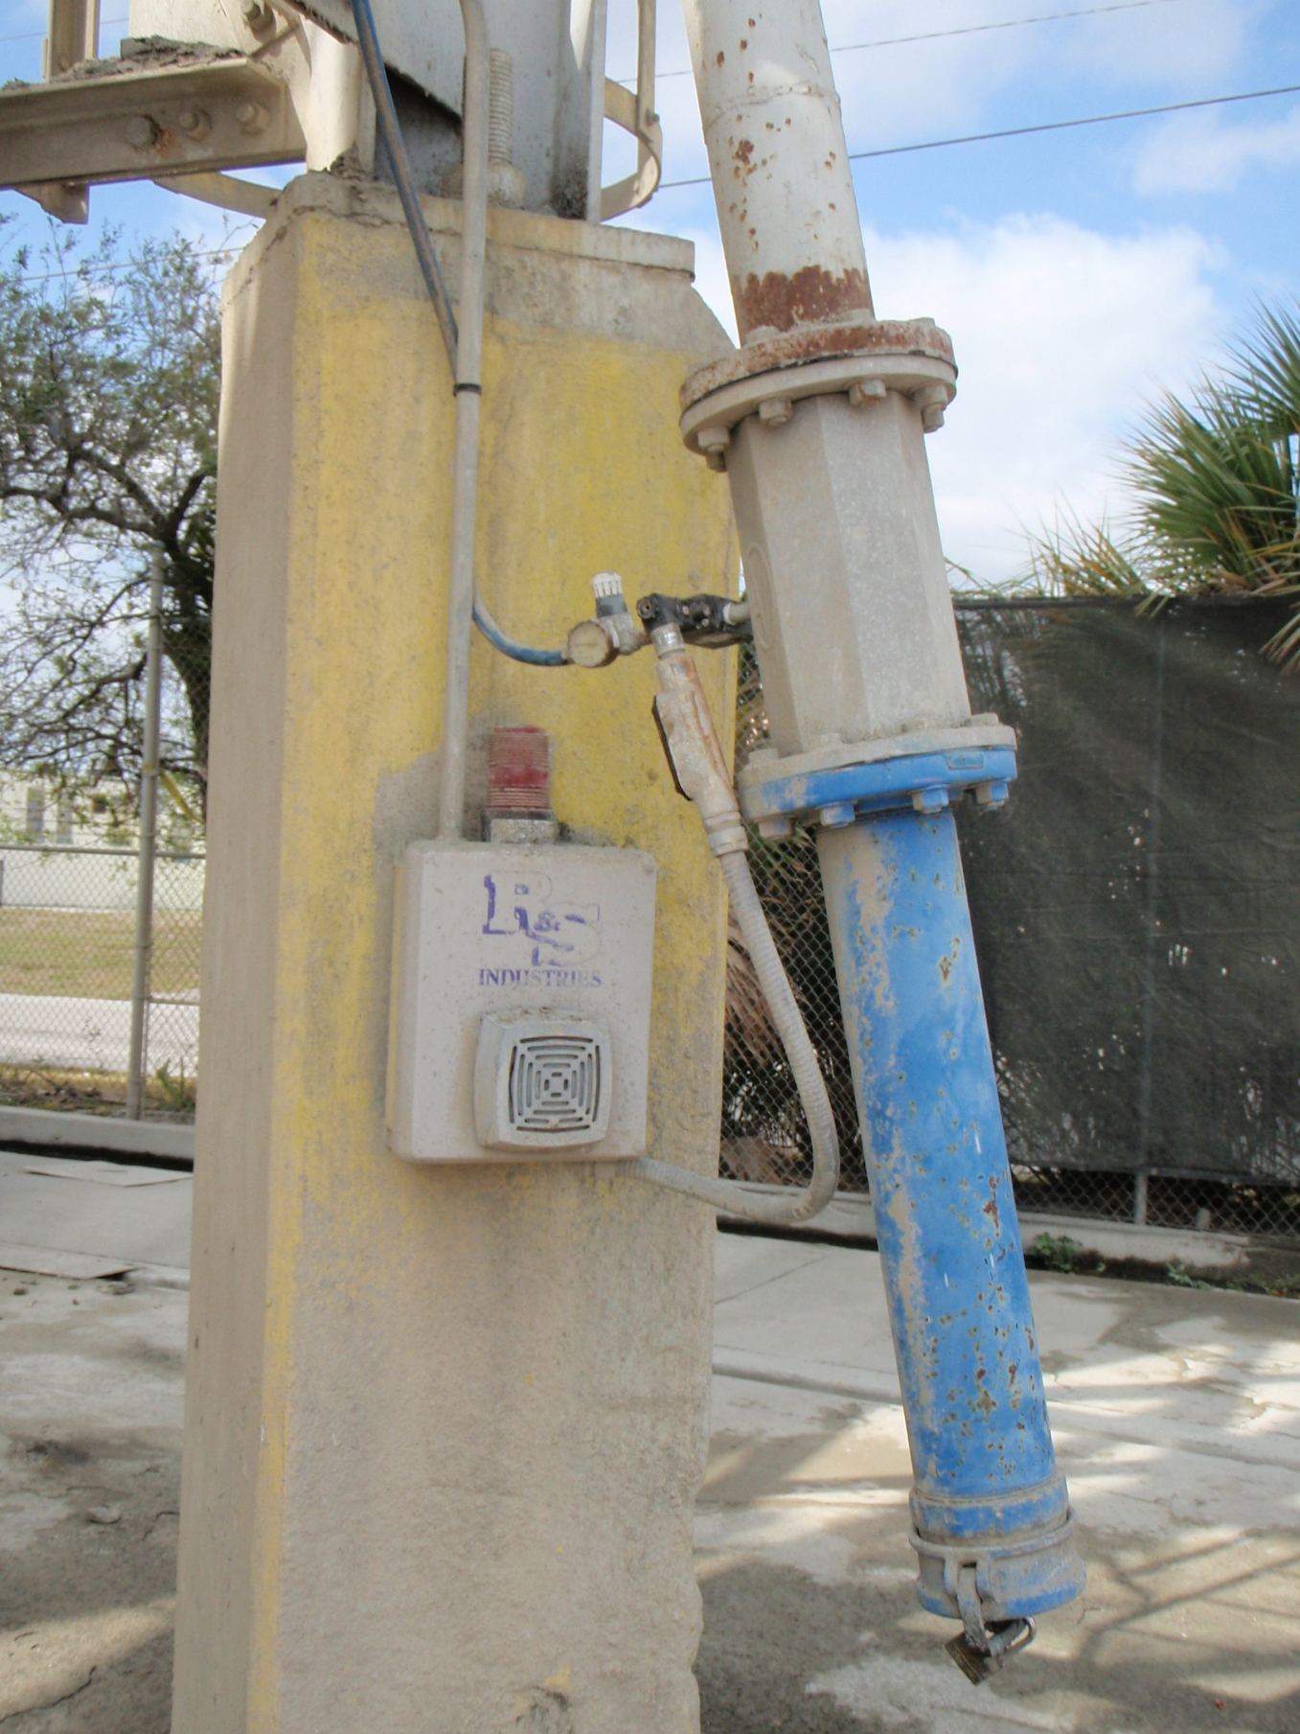
System that failed to shut off. An employee of the facility believes it was tampered with.

Slide 4
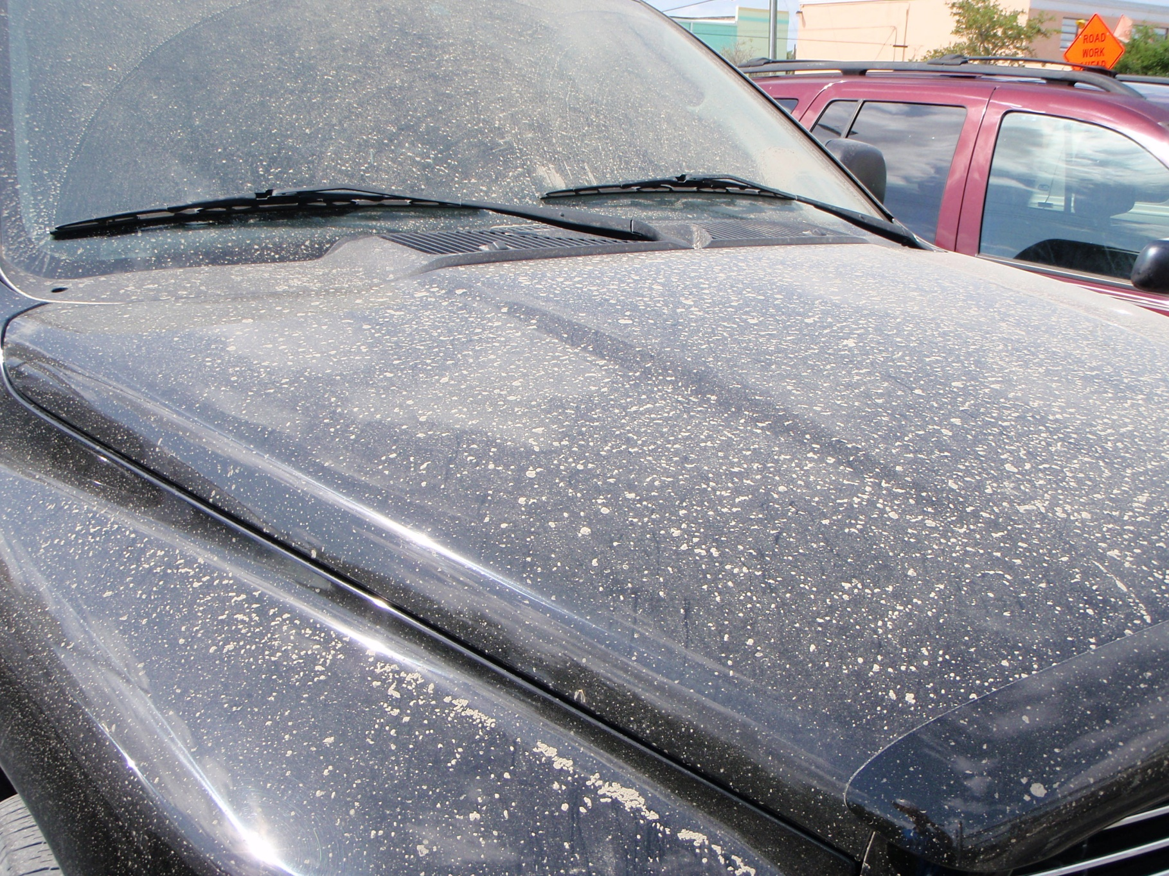
Employee’s vehicle from Select Auto. He arrived at work at 7:15, most arrive 8:00.

Slide 5
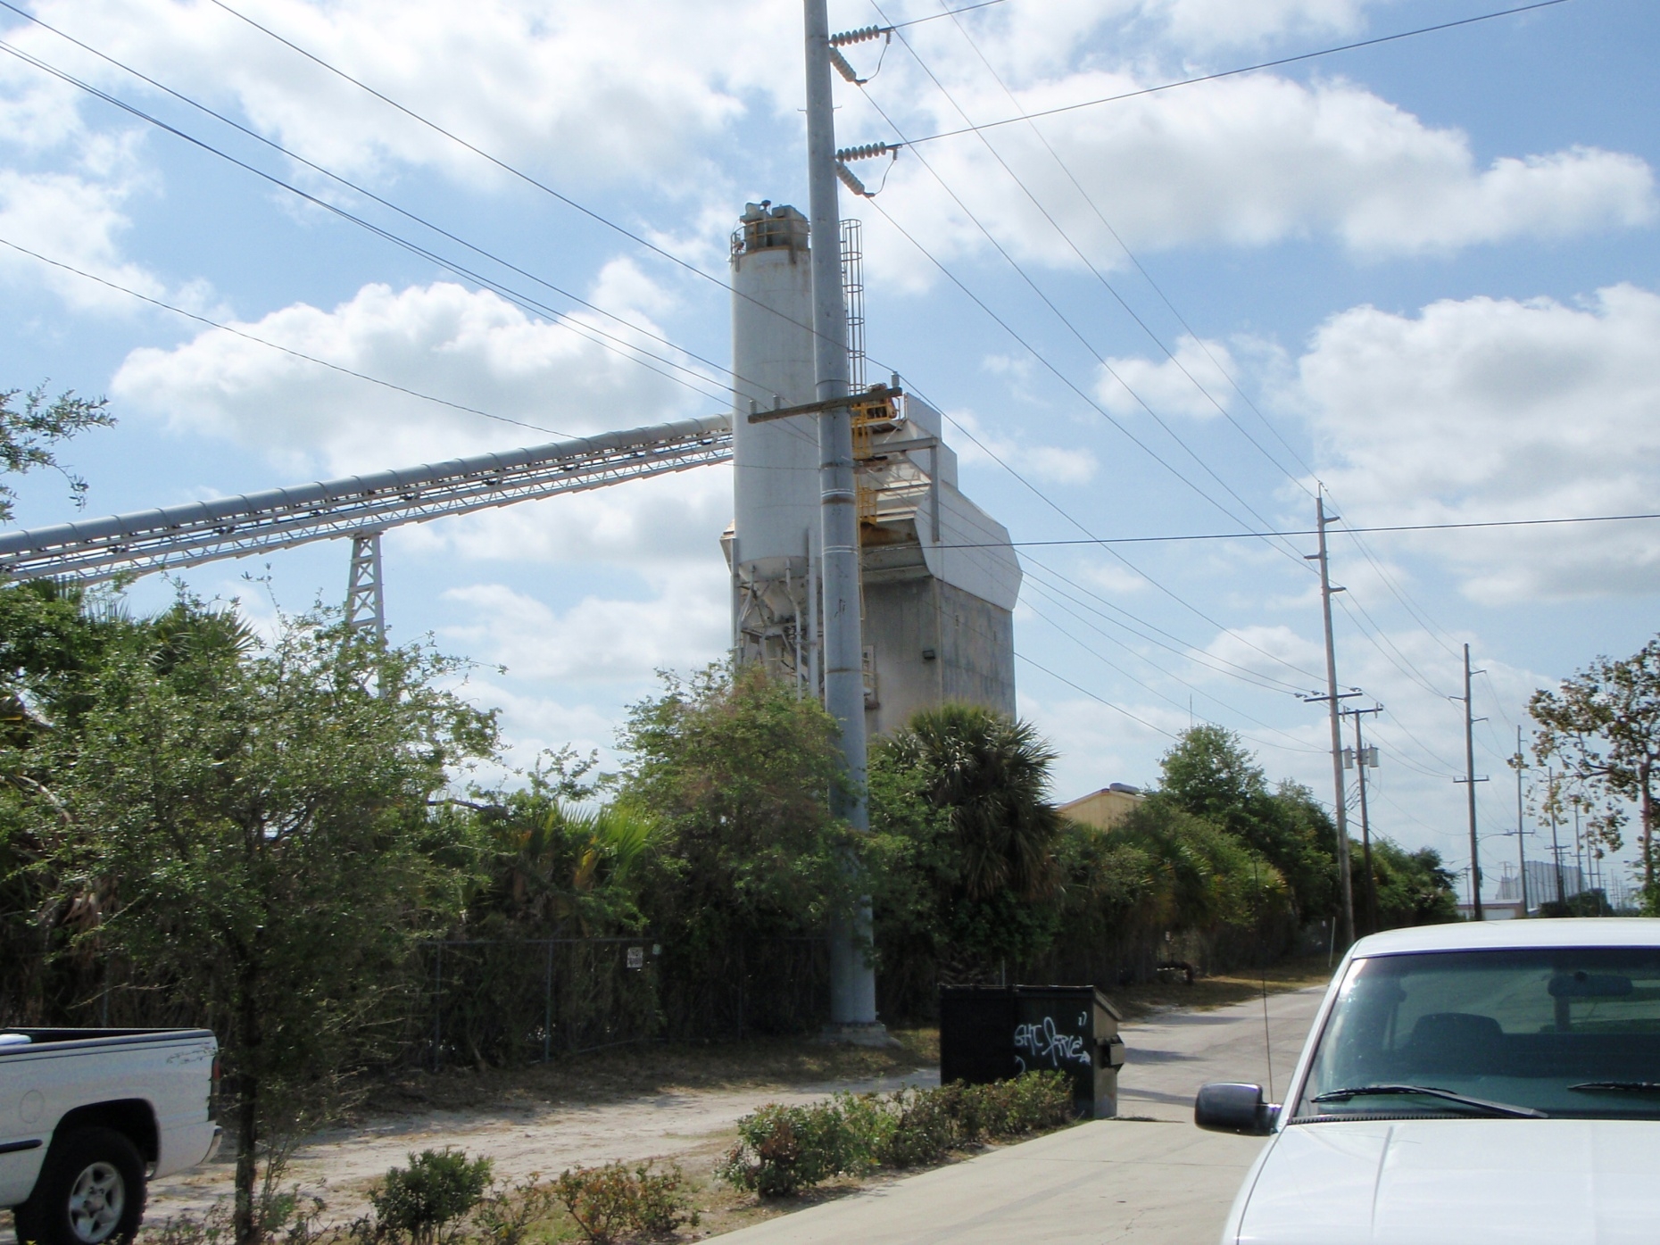
View of the facility from the auto dealership.

Slide 6
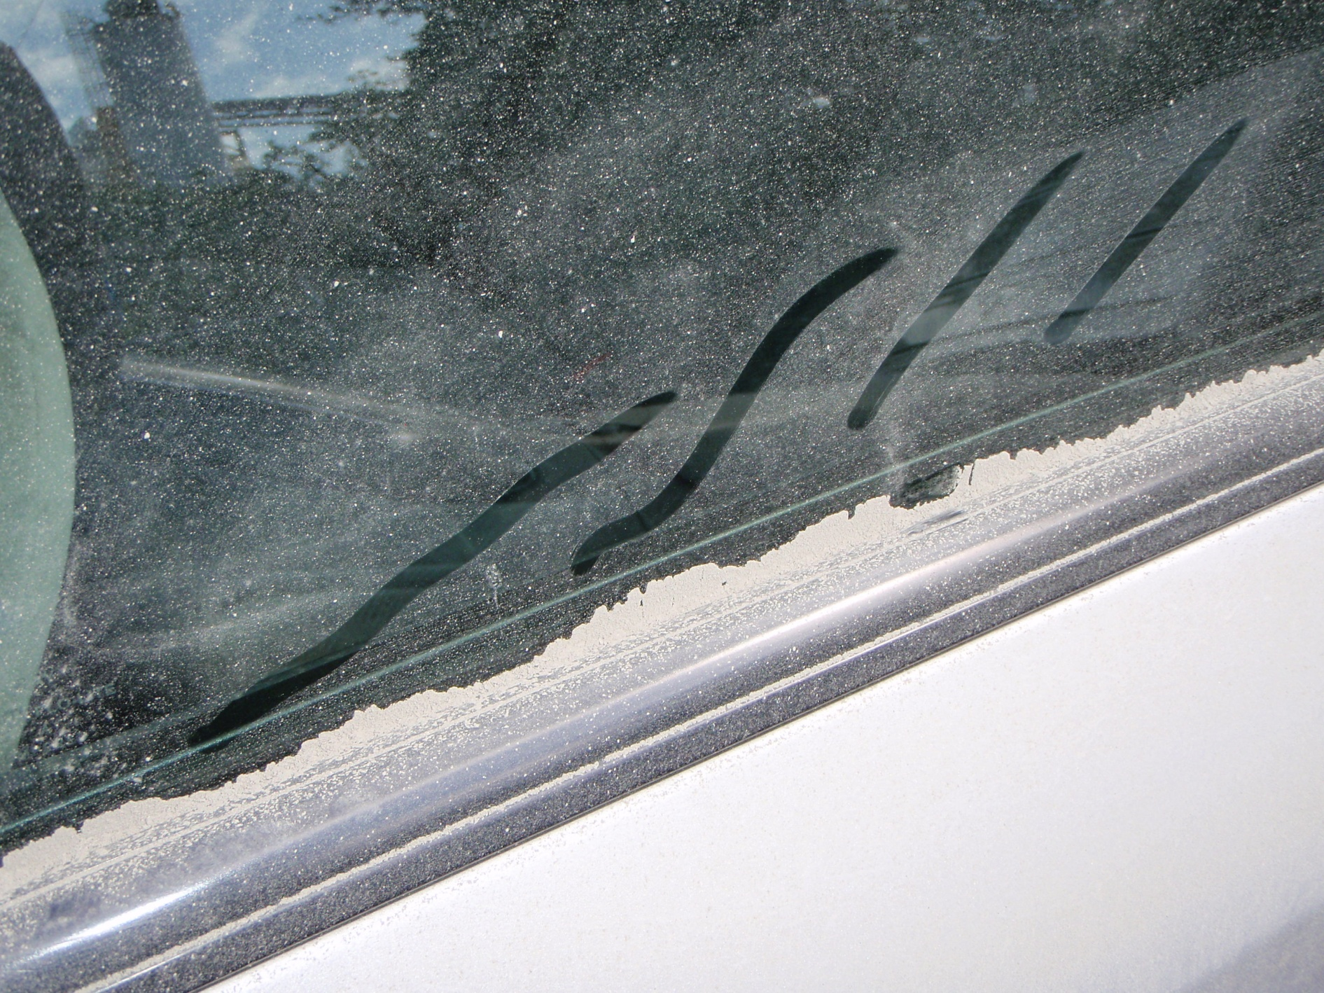
A vehicle in the automobile lot.

